Slide 1

dracOs Forensic Flavor
Satria Ady Pradana

Slide 2
# whoami?
Satria Ady Pradana
Junior Security Analyst at MII
Researcher at dracOS Dev Team
Interest in low level stuffs

Slide 3
Here Comes, dracOs
A lightweight and powerful linux distribution.
Built from scratch.
A research for all.
A linux not only for penetration testing but cyber-security related activity, including digital forensic.

Slide 4
The State of Forensic in dracOs
Current
Integrating modern open-source forensics tools to dracOs.
Creating guide and “how to” for using dracOs and its tools.
Next plan
Live CD for forensic acquisition and analysis.
Develop tools for forensic.
Open research discussion.

Slide 5
What is Digital Forensic?
Forensic – scientific process in collecting, preserving, analyzing evidence during the course of an investigation.
Digital Forensic – branch of forensic where the object of investigation is electronic especially digital data.
Preservation, identification, extraction, interpretation, and documentation of digital evidence which can be used in the court of law.

Slide 6
The Essence of Digital Forensic
Solving a puzzle.
Reconstruct an event or draw a conclusion from evidence.
Financial fraud.
Hacking / security breach.
Crimes using electronic / cyber.

Slide 7
Forensic Stages
Commonly consists of 3 stages:
Acquisition
Analysis
Reporting

Slide 8
Acquisition
Collecting and preserving the evidence.
Duplicate the source of evicende (ex: disk, flash drive, sd card, RAM).
Ensure integrity of data in certain level.

Slide 9
Analysis
Examine the content of source.
Identify evidence that either supports or contradicts a hypothesis or for sign of tampering (to hide data).
Should be able to be reproduced by other examiner.

Slide 10
Some Question to Address
What files / artefacts have been deleted from digital device?
What other digital devices has been connected to this system?
Was this system attacked or modified by someone over the network?
Can we know how the breach happen?
Can a remote system or user be located or identified?
What sites on internet were visited by this system?
Was this audio-recording altered?

Slide 11
Was this image counterfeit?
Can this image / video-recording be enhanced to help identify someone?
Can the physical characteristics of an object in photograph be determined?
Can individuals be determined?
Can unknown victims be located or identified based on phone number, email, etc?
Can pattern of offender activity related to the investigation be reconstructed?
etc

Slide 12
Analysis Category
At dracOs research, we divide the fields of techniques and analysis to several categories:
By device type
By volatility
By format type

Slide 13
By Device Type
Computer (desktop, laptop)
Mobile device (cell phone, tablet, PDAs)
Embedded & IoT

Slide 14
By Volatility of Source
Memory
Disk (HDD, SSD, SD card, ...)

Slide 15
By Format Type
Network (traffic and activity on network)
Logs (server log, event log, ...)
Database (database and related metadata)
Document
Image forensic (digital picture analysis)
Video forensic (digital video analysis)
Audio forensic

Slide 16
Anti-Forensic
Data hiding
Artefact wiping
Trail obfuscation
Attack against Forensic Process or Tools

Slide 17
Role of Linux & FOSS
Open Source bring openness to the idea and knowledge.
Transparency, all source code can be reviewed and openly validated.
Knowledge not depends on region, funding, and level of country development.
Encourage collaborative moves.

Slide 18
Perception of Linux by Gov
Linux is HARD
CLI stuffs
Too many commands, hard to remember
Not easy to get started
Not many professional (and easy) tools available.
Is it?

Slide 19
drac0s offers?
Arsenal of open source tools, for acquisition and analysis.
The power of open source and linux with DIY flavor.

Slide 20
Tools Category (so far)
Disk Imaging & Hashing
Data Carving & Extraction
File Analysis
Antimalware
Document Metadata Extraction
Memory Analysis
Network Forensic
Mobile Forensic

Slide 21
In current state, most tools are analysis tools. We are working for acquisition.
Some tools might not be mentioned due to limited time.
We mention only most interesting project for each category.

Slide 22
Disk Imaging & Hashing
To acquire disk image and verify the integrity.
Also to mount the image for analysis if necessary.
Challenges: multiple kind of media.
Some tools of trade:
dd
Ewfacquire
ssdeep

Slide 23
File Carving & Extraction
To extract data from image, hidden or not.
Challenges: multiple possible format.
Some tools:
Foremost
Bulk_Extractor

Slide 24
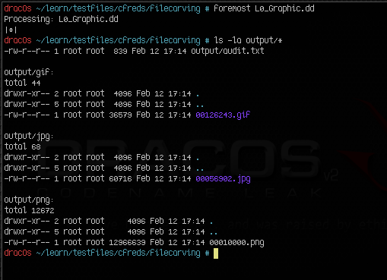
foremost

Slide 25
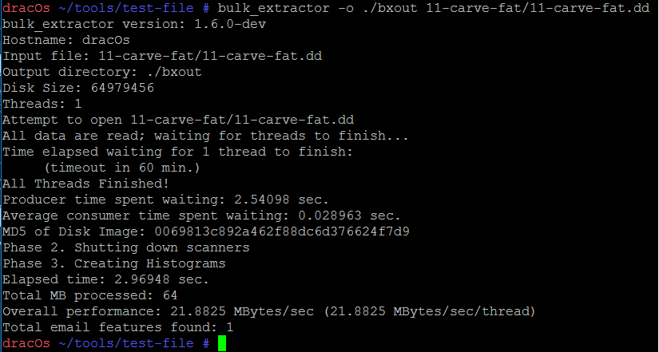
Bulk Extractor

Slide 26
File Analysis
Analyze a single file and determine what it is.
Binary, document, link,photo, video, email, etc.

Slide 27
Anti Malware
Check whether system is infected by malware.
Some tools:
rkhunter

Slide 28
Document Metadata Extraction
Has special purpose to analyze document and metadata extraction.
At this stage, only PDF and photo (EXIF) available.

Slide 29
Memory Analysis
Analyze memory dump and determine various state an operating system in.
Some tools:
Volatility

Slide 30
Network Forensic
Analyze network traffic and draw conclusion about what happen in network from log (mainly).
Some tools:
Tshark (from Wireshark suite).
Xplico

Slide 31
Mobile Forensics
Acquire and analysis artefact from mobile phone.

Slide 32
Log Analysis
Analyze various logs produced by system.
In this stage, only Windows Event Log tools included.
Some Tools:
evtkit

Slide 33
Password Recovery
Obtain password from locked system / archive.
Might need table to do so.

Slide 34
How to Contribute?
dracOs is open source project.
Still far from perfect.
Anyone can contribute.
Report bug
Give suggestion for what should be included (and why this awesome tools are needed).
Test installation of a software on dracOs.
Be a package maintainer for dracOs ecosystem.
Use dracOs for forensic and let us know.
Spread the word!

Slide 35

Question?

